Slide 1
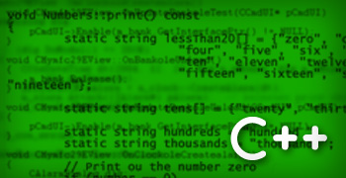
Ch. 4: tokens and expressions

Slide 2
Analogy between learning English and C++ language
Steps in learning English Language
Alphabets
Words
Sentence
Paragraphs
Steps in learning C++
Alphabets, Digits, Special Symbols
Constants, Variables, Keywords
Instructions
Programs

Slide 3
C++ Character set
Character set is a set of valid characters that a language can recognize.
C++ character set consists of letters, digits, special characters, white spaces.
Letters → ‘a’, ‘b’, ‘c’,………..’z’ Or ‘A’, ‘B’, ‘C’,……….’Z’
(ii) Digits → 0, 1, 2,……………………9
(iii) Special characters → ;, ?, >, <, &,{, }, [, ]……
(iv) White spaces → ex. New line (\n)

Slide 4
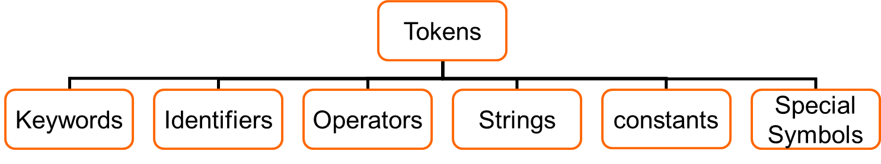
C++ Tokens
A token is a group of characters that logically belong together.
The programmer can write a program by using tokens. C++ uses the following types of tokens.

Slide 5
Keywords
These are some reserved words in C++ which have predefined meaning to compiler called keywords.
Keywords are not to be used as variable and constant names.
All key words have fixed meanings and these meanings cannot be changed.

Slide 6
Compiler specific keywords
Some commonly used Keyword are given below:
asm, auto, bool, break, case, catch, char, class, const, continue, default, delete, do, double, else, enum, explicit, export, extern, false, float, for, friend, goto, if, inline, int, long, mutable, namespace, new, operator, private, protected, public, register, return, short, signed, sizeof, static, struct, switch, template, this, throw, true, try, typedef, typeid, typename, union, unsigned, using, virtual, void, volatile, while

Slide 7
Identifiers
Symbolic names can be used in C++ for various data items used by a programmer.
A symbolic name is generally known as an identifier. An identifier is a name for a variable, constant, function, etc.
The identifier is a sequence of characters taken from C++ character set.

Slide 8
Identifier rules
An identifier should not be a keyword word of C++.
A valid identifier is a sequence of one or more letters, digits or underscore character (_).
Neither spaces nor punctuation marks or symbols can be part of an identifier
Only letters, digits and underline characters are valid
Variable identifiers always have to begin with a letter not with numbers.
They can also begin with an underscore character (_ ), but this is usually reserved for compiler specific keywords or external identifiers.
C++ is case sensitive that is upper case and lower case letters are considered different from each other.

Slide 9
Identifiers - examples
Examples of valid identifiers: First_name, age, y2000, y2k
Examples of invalid identifiers: 2000y
Identifiers cannot have special characters in them. For example: X=Y, J-20, ~Ricky,*Michael are invalid identifiers.
Identifiers are case-sensitive.
For example: Hello, hello, WHOAMI, WhoAmI, whoami are unique identifiers.

Slide 10
Constants
Constants are data items that never change their value during the execution of the program.
The following types of constants are available in C++.
Integer-Constants
Floating-constants
Character-constants
Strings-constants
Notes:
Additional information – Constants
Literals are the most obvious kind of constants. They are used to express particular values within the source code of a program.

Slide 11
Integer constants
Integer constants are whole number without any fractional part. C++ allows three types of integer constants.
Decimal integer constants : It consists of sequence of digits and should not begin with 0 (zero). preceded by optional “–” or “+” sign.
For example 124, - 179, +108.
Octal integer constants: It consists of sequence of digits starting with 0 (zero).
For example. 014, 012.
Hexadecimal integer constant: It consists of sequence of digits preceded by ox or Ox.
For example 0x34, 0x8AF.

Slide 12
Simple C++ program
//Program to find sum of two inputs.
#include <iostream.h> //preprocessor directive & header file
#include<conio.h>
void main() // program entry point
{ // block of statements: Begin
int a, b; // integer variables with data type integer
int sum;
a=10;
cout << "Enter the second number: ";
cin >>b; // Variable ‘b’ value is input using >> op
sum = a + b;
cout << “Sum =\n“, sum;
} // block of statements: End

Slide 13
Floating constants
They are also called real constants. They are numbers having fractional parts.
They may be written in fractional form or exponent form.
A real constant in fractional form consists of signed or unsigned digits including a decimal point between digits.
E.g.; 213.45, .456,234.
An exponent form has the form mantissa e exponent
E.g.; 0.56e4, 3.12E4 , -4.6E-1

Slide 14
Character constants
A character constant in C++ contains one or more characters.
They must be enclosed in single quotation marks. For ex: 'A', '9', etc.
Nongraphic characters which cannot be typed directly from keyboard, e.g., backspace, tab, carriage return etc. can be even used as characters.
An escape sequence represents a single character. The following table gives a listing of common escape sequences.
Escape Sequence Nongraphic Character
\a Bell (beep)
\n Newline
\r Carriage Return
\t Horizontal tab
\0 Null Character

Slide 15
String constants
A sequence of characters enclosed within double quotes is called a string constant.
A string constant is by default (automatically) added with a special character ‘\0' which denotes the end of the string.
Therefore the size of the string is always = number of characters+1.
Characters may be letters, numbers, special characters and blank space.
E.g.: “hello”, “2007”, “T”, “4+5”
Notes:
Additional information – String constants
For example "COMPUTER" will re represented as "COMPUTER\0" in the memory and its size is 9 characters.

Slide 16
Example for data types usage
#include<iostream>
using namespace std;
int main()
{ int age;
float height;
char gender;
char name[10];
cout<< "Enter your age\n";
cin>>age;
cout<< "Enter your height\n";
cin>>height;
cout<< "Enter your gender\n";
cin>>gender;
cout<< "Enter your name\n";
cin>>name;
cout<< "name=\n" <<name << "age=\n"<<age << "gender=\n"<<gender;
<<"height=\n"<<height;
}

Slide 17

Variables
Variables are data storage locations in the computer’s memory.

Slide 18
Variables
A variable is a data name that may be used to store a data value.
A variable may take different values at different times during execution.
Variable name should be chosen by the programmer in a meaningful way.
The rules for giving name to a variable is similar to an identifier.

Slide 19
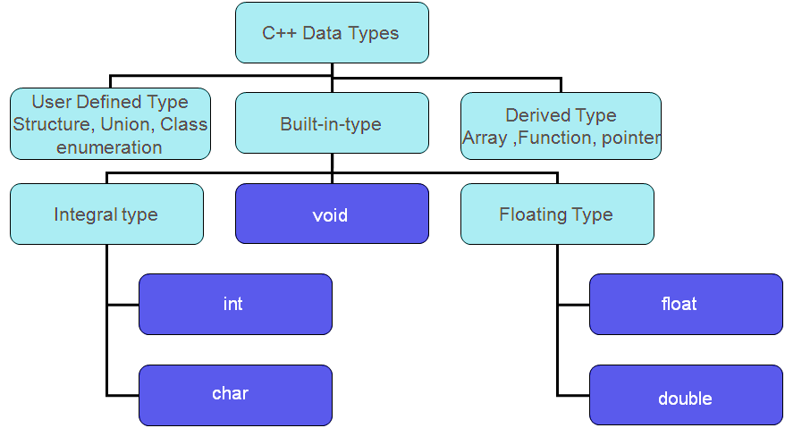
C++ data Types
Notes:
The data type allows the user/programmer to select the type appropriate to the needs of the application as well as machine.
ALL C compilers support 5 fundamental data types

Slide 20
Data types
In C++ there are mainly 3 classes of data types
Primary (fundamental or Built-in type) data types
User defined Data types
Derived Data types
The fundamental or Built-in data types fall into one of following categories
integer type
floating-point type
character type
void

Slide 21
Primary (built-in or Basic)Data types
INTEGER
CHARACTER
SIGNED TYPE UNSIGNED TYPE
INT UNSIGNED INT
SHORT INT UNSIGNED SHORT INT
LONG INT UNSIGNED LONG INT
SIGNED CHARACTER
UNSIGNED CHARACTER
FLOATING POINT TYPE
VOID
FLOATING POINT TYPE
FLOAT
DOUBLE
LONG DOUBLE
VOID

Slide 22
Integer Types
The basic integer type is int
The size of an int depends on the machine and on PCs it is normally 16 or 32 or 64 bits.
modifiers
short: typically uses less bits
long: typically uses more bits
unsigned
Signed

Slide 23
Size and Range of values for a 16-bit Machine (Integer type)
 | Type | Size | Range
short | short int or signed short int | 8 | -128 to 127
 | unsigned int | 8 | 0 to 255
integer | int or signed int | 16 | -32,768 to 32,767
 | unsigned int | 16 | 0 to 65,535
long | long int or signed long int | 32 | -2,147,483,648 to 2,147,483,647
 | unsigned long int | 32 | 0 to 4,294,967,295

Slide 24
Character Types
Character type char is related to the integer type.
Modifiers unsigned and signed can be used
char →1 byte (-128 to 127)
signed char →1 byte (-128 to 127)
unsigned char →1 byte (0 to 255)
ASCII (American Standard Code for Information Interchange ) is the dominant encoding scheme for characters.
Examples
' ' encoded as 32 '+' encoded as 43
'A' encoded as 65 'Z' encoded as 90
'a' encoded as 97 'z' encoded as 122

Slide 25
Floating-Point Types
Floating-point types represent real numbers
Integer part
Fractional part
The number 108.1517 breaks down into the following parts
108 - integer part
1517 - fractional part
There are three floating-point types
float
double
long double

Slide 26
SIZE AND RANGE OF VALUES FOR 16-BIT MACHINE (FLOATING POINT TYPE)
 | Type | Size
Single Precision | float | 32 bits 4 bytes
Double Precision | double | 64 bits 8 bytes
Long Double Precision | long double | 80 bits 10 bytes

Slide 27
void
2 uses of void are
To specify the return type of a function when it is not returning any value.
To indicate an empty argument list to a function.

Slide 28
Boolean
Logical or Boolean data type is named after a French Mathematician/philosopher George Boole
Consists of only two values: true and false
Nonzero number can be used to represent true
Zero is used to represent false

Slide 29
Symbolic constants
These helps us to associate an identifier with a constant value in a program.
const keyword tells the compiler that the value of variable should not be modified by the program.
We can declare a symbolic constant as follows:
Syntax:
const data-type identifier = value;
Example:
const float pi=3.14;
const int independence = 1947;

Slide 30
C++ program using symbolic constants
Int main()
{
float area, perimeter, radius;
const float pi = 3.14159;
clrscr();
cout<<“Enter the radius”;
cin>>radius;
area = radius * radius * pi;
perimeter = 2 * Pi * radius;
cout <<“Area = “<<area <<“Perimeter =”<<perimeter;
}

Slide 31
Declaration of variables
In order to use a variable in C++, we must first declare it.
Declaration of variables does two things
Tells the compiler the variable name.
Specifies the type of data.
Syntax:
Write the specifier of the desired data type (like int, char, float...) followed by a valid variable identifier.
data-type V₁, V₂,…,V_{n;}
Example:
int age;
float amount, height;

Slide 32
Declaration of variables cntd..
Signed and unsigned specifiers can be used during variable declarations.
Example:
signed int age;
unsigned int age;
short and long specifiers can also be used during variable declarations. The following two variable declarations are equivalent:
Example:
short int age;
long int age;

Slide 33
Assigning values to variables
Variables can be assigned values using the assignment operator ‘ = ’
It is possible to assign values at the time of declaration.
Syntax:
data-type varaiable-name=constant;
Example:
int age; OR int age = 25;
age = 25;
The process of giving initial values to variables is called “variable Initialization”.

Slide 34
Initialization of variables example
#include <iostream.h>
void main ()
{
int a=5; // initial value = 5
int b;
b=2; // initial value = 2
int result; // initial value undetermined
a = a + 3;
result = a - b;
cout << result;
}

Slide 35
User defined Type declarations
typedef
Type definition - lets you define your own identifiers.
Syntaxr:
typedef type identifier;
The “type” refers to an existing data type and “identifier” refers to the new name given to that data type.
Example:
typedef int marks;
typedef float units;
marks m1,m2; //m1 & m2 are declared as integer variables
units u1, u2; //u1 & u2 are declared as floating point variables
The main advantage of typedef is that we can create meaningful data type names for increasing the readability of the program.

Slide 36
Dynamic initialization of variables
C++ permits initialization of the variable at run time. This is referred to as dynamic initialization.
In C++, a variable can be initialized at run time using expressions at the place of declaration.
Example:
int a=3,b=2,rad=10;
int n= pow(a,b);
float area= 3.14159*rad*rad;

Slide 37
Example for Dynamic initialization of variables
#include <iostream>
using namespace std;
int main()
{
int number,devisor;
cout<<"\n Enter number:";
cin>> number;
cout<<"\n Enter devisor:";
cin>>devisor;
float average=(number/devisor); /*This is dynamic initialization*/
cout<<"AVERAGE is: "<<average;
}

Slide 38
Reference variables
A reference variable is an alias, that is, another name for an already existing variable.
Once a reference is created for a variable, either the variable name or the reference name may be used to refer that variable.
Example:
int i = 17;
We can declare a reference variable ‘r’ for ‘i’ as follows.
int & r = i;
Read the & in these declarations as reference. Thus, read the declaration as "r is an integer reference initialized to i" .
Now both ’i’ and ’r’ are the same variables.

Slide 39
Example for reference variables
#include <iostream>
using namespace std;
int main ()
{
int i; float d; // declare simple variables
int& r = i; // declare reference variables
float& s = d;
i=5 // assign values to variables
d = 11.7
cout << "Value of i : " << i << "Value of i reference : " << r ;
cout << "Value of d : " << d << "Value of d reference : " << s
}
Output: Value of i : 5 Value of i reference : 5
Value of d : 11.7 Value of d reference : 11.7

